Slide 1
Manufacturing Operations & Quality Analytics System
Excel cleaning, statistical analysis and Power BI dashboards
BMAI Final Project
Project by C Jones Paulraj
Notes:
Opening: this deck covers the Excel data cleaning (Phase 2), the statistical analysis (Phase 3) and the four Power BI dashboards built in Phase 5, and what they tell plant leadership.

Slide 2





The problem: inefficiency across the shop floor
Machine breakdowns
Rising repair costs
Stock imbalance
Missed deadlines
Quality losses
Frequent unplanned downtime
Maintenance spend keeps climbing
Raw material stockouts and overstock
Orders finishing after the expected date
Growing defect and rejection rates
The goal
A data-driven system that finds bottlenecks from machine reliability to scheduling, materials and quality, and recommends actions to reduce downtime, control production cost and improve overall equipment effectiveness (OEE).
Notes:
A mid-to-large discrete manufacturer faces five linked problems. Leadership wants one analytics system covering the whole floor.

Slide 3





Five phases from raw data to dashboards
Phase 1
Phase 2
Phase 3
Phase 4
Phase 5
Data understanding
Cleaning in Excel
Statistical analysis
MySQL
Dashboards
Five raw tables, data dictionary and keys (Machine_ID, Work_Order_ID, Product_SKU)
Null summary, duplicates, labels and invalid rows removed
Descriptive stats, correlations, RFM scores, tier analysis and pivot
Schema manufacturing_ops_db, 15 analytical queries and a master fact view
Four-page Power BI report connected to the database
Output
Output
Output
Output
Output
Data dictionary and key map
Five clean CSV files
Statistics workbook
15 query results
Four dashboard pages
Notes:
Phases 1-4 prepared the data; Phase 5 turns it into the four dashboards presented next.

Slide 4
Phase 2: start with a Null Summary Table
Excel only, no Python. Each column of the five tables gets one row with:
Column name
Null count
Null percentage
Planned action
Table | Column | Planned action | Nulls left
Machine_Master | Avg_Changeover_Time_Mins | Fill with Machine_Category median | 0
Raw_Material_Inventory | Numeric stock fields | Fill with Material_Category median | 0
Production_Orders | Order_Date | Keep the row, leave the date blank | 48
Machine_Master | Contact_Technician_Email | Leave blank, not used in analysis | 47
Nulls left = still blank in the cleaned tables. Downtime_Maintenance and Quality_Defects have none.
So what: Medians fill gaps without being pulled by outliers. Only 47 emails and 48 order dates stay blank.
Notes:
Phase 2 is done in Excel only. Before any cleaning, a Null Summary Table lists every column with its null count, null percentage and the planned action. The table shows the planned action for each column and how many nulls remain after cleaning: 47 technician emails and 48 order dates. Downtime_Maintenance, Quality_Defects and Raw_Material_Inventory have no nulls left.

Slide 5
Phase 2: cleaning the machine and order tables
Machine_Master · 1,015 machines
Production_Orders · 47,724 orders
Standardise labels: "cnc" becomes CNC Machine; 8 categories and 6 plant locations remain.
Remove duplicates: duplicate Machine_IDs dropped, 1,015 unique machines.
Flag OEE_Score: 52 machines are outside 0–100 and marked Out of Range.
Fill nulls: missing Avg_Changeover_Time_Mins gets the category median.
Machine_Tier: Tier 1 ≥80 (290), Tier 2 60–79 (492), Tier 3 <60 (181), Review (52).
Standardise status: 5 labels: Completed, Scrapped, Cancelled, In Progress, On Hold.
Remove invalid rows: negative Planned_Quantity and Unit_Cost_INR deleted.
Validate dates: no Actual_Completion_Date falls before Order_Date.
Delay and flag: Completion_Delay_Days = actual minus expected date; Late_Completion = 1 if delay > 0.
Total_Order_Value: Planned_Quantity × Unit_Cost_INR, ₹36.79bn in total.
So what: every machine now has one valid tier and OEE flag, and every order carries a delay, a late flag and a value.
Notes:
Machine_Master: labels standardised (cnc becomes CNC Machine), duplicates removed, OEE flagged outside 0-100, changeover nulls filled with the category median and a tier added. Production_Orders: status labels standardised, negative quantity and cost removed, dates validated, delay and late flag calculated, and total order value added.

Slide 6
Phase 2: cleaning inventory, downtime and defects
Raw_Material_Inventory
28,228 records
Downtime_Maintenance
19,890 events
Quality_Defects
4,905 records
Negative Stock_On_Hand removed; nulls filled with category median
Turnover = Units_Consumed_Last_Month × 12 ÷ Avg_Stock_On_Hand
Stockout_Risk: stock at or below reorder level (3,217)
Overstock_Risk: stock above 4× reorder level (8,396)
Product_SKU checked against orders: 28,222 match, 6 do not
Downtime_Type reduced to 4 labels; Resolved_Flag set to Yes or No
Negative Repair_Cost_INR removed; start and end dates validated
Downtime_Duration_Hours = end minus start (average 4.3 h)
Month_Start column added for monthly trends
Duplicates and zero or negative Defect_Qty removed
Defect_Type (5 labels) and Disposition_Status (4 labels) standardised
Defect_Value = Defect_Qty × Unit_Cost_INR
High_Value_Defect = 1 above the 75th percentile, ₹29.3K (1,226 records)
Output: five cleaned CSVs for SQL import: 1,015 machines · 47,724 orders · 28,228 stock records · 19,890 downtime events · 4,905 defects.
Notes:
Raw_Material_Inventory: negative stock removed, nulls filled with category median, turnover rate calculated, stockout and overstock flags added, SKUs checked against production orders. Downtime_Maintenance: labels standardised, negative repair cost removed, dates validated, duration and month start calculated. Quality_Defects: duplicates and zero quantity removed, labels standardised, defect value and high-value flag calculated. The overstock rule (stock above 4 times reorder level) is a project assumption. Five cleaned CSVs were exported for SQL import.

Slide 7
Phase 3: descriptive statistics of key columns
Metric | Mean | Median | Mode | Std dev | Min | Max | Q1 | Q3
OEE score (%) | 74.2 | 74.1 | 66.3 | 15.5 | 30.5 | 138.7 | 64.5 | 83.6
Completion delay (days) | 2.2 | 2 | 0 | 5.4 | −19 | 32 | −1 | 6
Order value (₹K) | 771 | 673 | 0 | 548 | 0 | 4,123 | 323 | 1,121
Repair cost (₹K) | 25.2 | 25.3 | 1.4 | 14.3 | 0.5 | 50.0 | 12.9 | 37.5
Downtime (hours) | 4.3 | 4.0 | 3.9 | 2.6 | 0.0 | 15.7 | 2.2 | 6.1
Defect value (₹K) | 19.9 | 15.1 | 4.3 | 17.0 | 0.1 | 108.3 | 6.3 | 29.3
Material turnover (×/yr) | 15.6 | 7.2 | 7.4 | 371.1 | 0.0 | 43,656 | 4.6 | 11.2
Computed on the cleaned tables. ₹K = thousand rupees. Q1 and Q3 are the 25th and 75th percentiles.
So what: mean and median agree for OEE, delay, repair cost and downtime. Turnover and defect value are skewed, so use the median.
Notes:
Phase 3 is also done in Excel, on the cleaned tables. Functions used: AVERAGE, MEDIAN, MODE.SNGL, STDEV.S, MIN, MAX and QUARTILE.INC. OEE, delay, repair cost and downtime have a mean close to the median. Material turnover and defect value are right-skewed: one turnover value reaches 43,656, so the median (7.2) is the better measure. The 52 OEE values above 100 are flagged, not removed. Mode of a continuous value is of limited use.

Slide 8
Phase 3: correlation analysis
OEE_Score vs Completion_Delay_Days
Repair_Cost_INR vs Downtime_Duration_Hours
−0.001
−0.004
correlation coefficient r · 47,724 orders; at machine level r = −0.010
correlation coefficient r · 19,890 downtime events
−1
0
+1
−1
0
+1
No linear relationship. Machines with a higher OEE do not finish orders sooner.
No linear relationship. Longer stops do not cost more to repair.
So what: OEE alone does not explain late orders, so look to scheduling and capacity. Repair cost is not driven by how long a stop lasts.
Notes:
CORREL in Excel. OEE_Score vs Completion_Delay_Days: r = -0.001 across 47,724 orders (OEE looked up from Machine_Master by Machine_ID); at machine level (1,015 machines) r = -0.010. Repair_Cost_INR vs Downtime_Duration_Hours: r = -0.004 across 19,890 events. Both are effectively zero, so there is no linear relationship.

Slide 9
Phase 3: machine RFM scores and segments
Recency
Months since the last work order, to 18 Jun 2024. Range 0–5.5, median 0.4. Fewer months scores higher.
Machines per segment (total score)
R
Frequency
Total work orders handled. Range 26–73, median 47.
F
Monetary
Total production value handled. Range ₹17.7M–₹62.5M, median ₹36.2M.
M
So what: 142 Champions handle about 56 orders each. The 93 Low Value machines handle about 39 and were last used earlier, so check their utilisation.
Notes:
Each of the 1,015 machines is scored on three dimensions, 1 to 5, using quintile cut-offs (PERCENTILE in Excel). Recency is months since the last work order, measured to the latest order date, 18 Jun 2024, and a more recent order scores higher. Frequency is the number of work orders and Monetary is total Total_Order_Value. The three scores add to 3-15, which sets the segment: Champions 13-15, Loyal 10-12, Potential 7-9, At Risk 5-6, Low Value 3-4. Champions average about 56 orders and were last used 0.2 months before the cut-off; Low Value machines average about 39 orders and 1.6 months.

Slide 10
Phase 3: late completion across machine tiers
Late completion rate by tier (% of orders)
Late_Completion by Machine_Tier
Tier | Orders | Late % | Avg delay (days)
Tier 1 | 13,466 | 58.8% | 2.30
Tier 2 | 23,267 | 58.5% | 2.24
Tier 3 | 8,562 | 58.3% | 2.23
Review | 2,429 | 57.4% | 2.09
Tiers 1–3 differ by 0.4 points. Review is the 52 machines with OEE above 100.
So what: about 58% of orders are late in every tier. Tier does not predict lateness, so scheduling is the lever.
Notes:
Late_Completion is 1 when Completion_Delay_Days is above 0. Grouped by Machine_Tier (orders joined to machines on Machine_ID): Tier 1 58.8% late on 13,466 orders, Tier 2 58.5% on 23,267, Tier 3 58.3% on 8,562, Review 57.4% on 2,429. Tier 1 to Tier 3 differ by only 0.4 points and average delays are 2.30, 2.24 and 2.23 days. Tier does not predict lateness. Review is the 52 machines with OEE above 100.

Slide 11
Phase 3: pivot of cost and orders by quarter
Product category | Q1 | Q2 | Q3 | Q4 | Total (₹bn) | Orders
Automotive Parts | 1.79 | 1.79 | 1.29 | 1.30 | 6.16 | 7,983
Consumer Goods | 1.83 | 1.80 | 1.23 | 1.27 | 6.13 | 7,831
Electronics | 1.82 | 1.74 | 1.31 | 1.34 | 6.20 | 8,106
Industrial Equipment | 1.84 | 1.66 | 1.21 | 1.25 | 5.97 | 7,803
Packaging Materials | 1.77 | 1.74 | 1.27 | 1.35 | 6.13 | 8,010
Textiles Machinery Parts | 1.78 | 1.82 | 1.31 | 1.25 | 6.16 | 7,943
Total | 10.83 | 10.55 | 7.61 | 7.76 | 36.76 | 47,676
Cost = sum of Total_Order_Value in ₹ billion. Quarter = calendar quarter of Order_Date, Jan 2022 – Jun 2024 combined. 48 orders without an order date are excluded.
So what: spend is level across the six categories (₹5.97–6.20bn). Q1 and Q2 look higher only because they cover three years, Q3 and Q4 two.
Notes:
Excel PivotTable: rows are Product_Category, columns are the calendar quarter of Order_Date (2022 to June 2024 combined), values are the sum of Total_Order_Value (shown in billion rupees) and the count of orders. The 48 orders with no order date are excluded, so the total is 36.76bn rather than 36.79bn. Q1 and Q2 hold three years of orders, Q3 and Q4 only two, which is why they look higher.

Slide 12
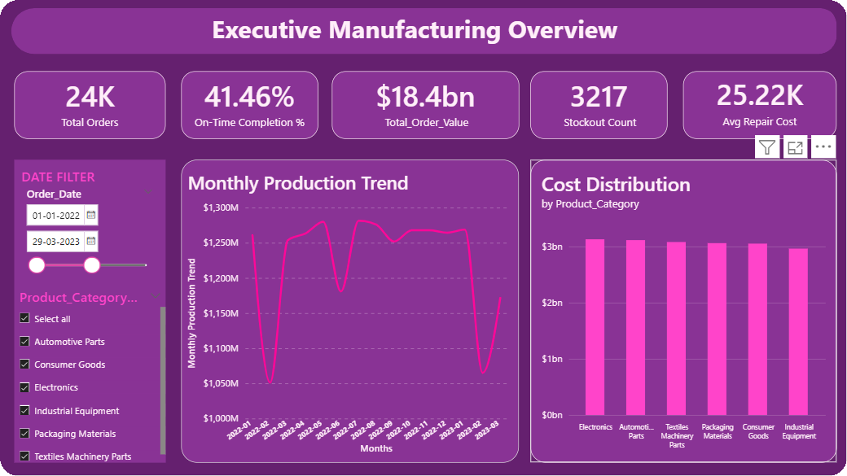
Dashboard 1: Executive Manufacturing Overview
The question it answers
Is our production completion performance meeting the 85% industry benchmark?
41.51%
orders on time vs an 85% benchmark
₹36.79bn
total production cost, 47,724 orders
3,217
stock records at or below reorder level
Screenshot shows the date slicer set to Jan 2022 – Mar 2023. Figures quoted in this deck use the full dataset (Jan 2022 – Jun 2024).
Notes:
The headline page. Five KPI cards, the monthly production trend and the cost split by product category. The key message is the on-time rate: 41.51% against an 85% benchmark.

Slide 13
Dashboard 1: what each visual tells us
Visual | What it shows | What we found
KPI cards | Orders, on-time %, cost, stockouts, repair cost | 47,724 orders; 41.51% on time vs 85% target; ₹36.79bn cost; 3,217 stockout-risk items; ₹25,217 avg repair cost.
Monthly Production Trend | Production value by order month | ₹1.0–1.4bn a month; rises to a Q3/Q4 peak then dips in Q1. No steady growth.
Cost Distribution | Production cost by product category | Evenly spread: Electronics highest (16.9%), Industrial Equipment lowest (16.2%).
Slicers | Order date and product category | Filter orders and cost. Stockout count stays fixed because inventory has no date link.
So what: About 6 in 10 orders finish late; spend is stable and evenly spread across categories.
Notes:
On-time performance is 43.5 points below benchmark. The late rate is about 58%. The last month of the data (June 2024) is incomplete, so ignore the drop at the end of the trend line.

Slide 14
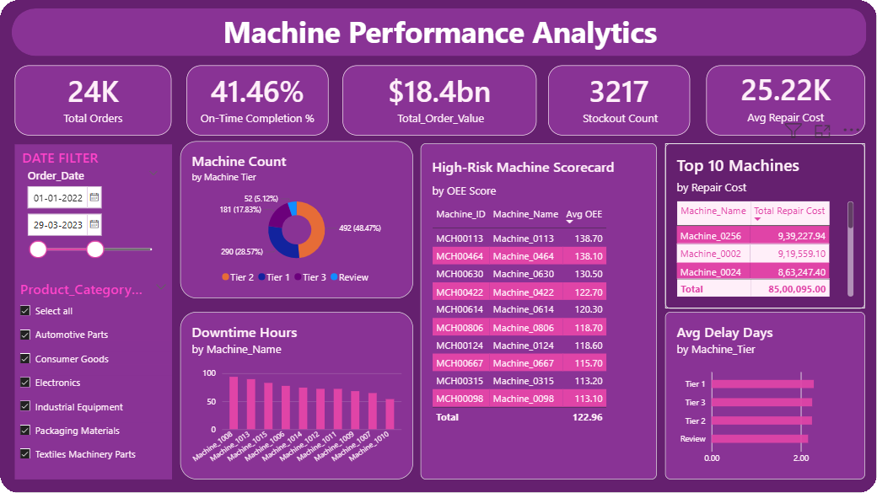
Dashboard 2: Machine Performance Analytics
The question it answers
Which machines are least reliable, and does machine tier matter?
45
machines fail all three risk checks
2.2–2.3 days
average delay in every machine tier
1.7%
of repair cost sits in the top 10 machines
Screenshot shows the date slicer set to Jan 2022 – Mar 2023. Figures quoted in this deck use the full dataset (Jan 2022 – Jun 2024).
Notes:
Machine-level view: tier mix, downtime, repair cost, delay by tier and the high-risk scorecard. Risk score = OEE below 60, downtime above 83.6 hours, defect rate above 0.33%.

Slide 15
Dashboard 2: what each visual tells us
Visual | What it shows | What we found
Machine Tier Distribution | Machines per OEE tier | Tier 1: 290 (28.6%), Tier 2: 492 (48.5%), Tier 3: 181 (17.8%). 52 machines have an impossible OEE above 100.
Downtime Hours (top 10) | Machines losing the most hours | Highest: Machine_0024 (149.5 h), Machine_0808 and Machine_0999 (about 148 h). Fleet average is 83.6 h.
Top 10 by Repair Cost | Where maintenance spend is highest | Machine_0256 ₹939K, Machine_0002 ₹920K. The top 10 hold ₹8.5M, only 1.7% of ₹501.6M.
Avg Delay by Machine Tier | Is a lower tier less reliable? | No: Tier 1 2.30 days, Tier 2 2.24, Tier 3 2.23. Tier does not predict delay.
High-Risk Scorecard | Machines failing all three checks | 45 machines; worst is MCH00252 (OEE 30.5). Conveyor Systems (10) and Injection Molding (9) lead.
So what: Problems are fleet-wide, so act on the 45 high-risk machines rather than on whole tiers.
Notes:
Tier (OEE band) does not predict delay, downtime or repair cost. Targeted action on the 45 machines that fail all three checks is more effective.

Slide 16
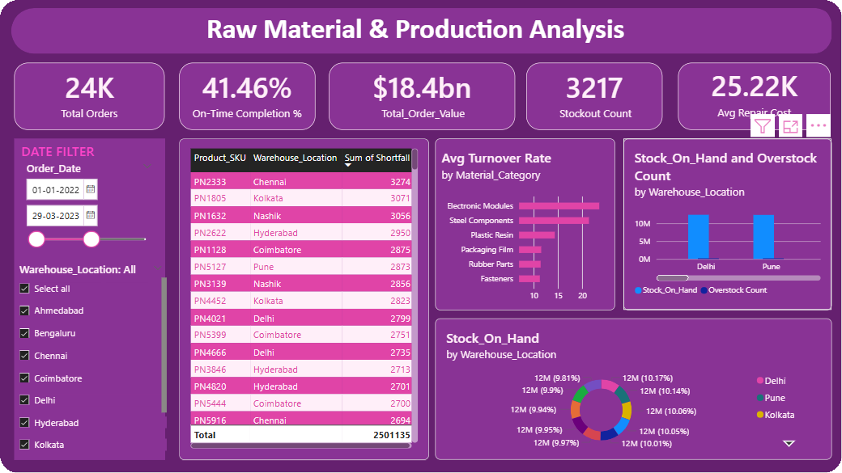
Dashboard 3: Raw Material & Production Analysis
The question it answers
Are stocks evenly distributed, and which warehouses carry the most risk?
3,217
stock records at or below reorder level
≈10%
of total stock held by each warehouse
11.3–23.5×
average yearly turns by category (median ≈ 7)
Screenshot shows the date slicer set to Jan 2022 – Mar 2023. Figures quoted in this deck use the full dataset (Jan 2022 – Jun 2024).
Notes:
Inventory view: items short of their reorder level, turnover by material category, stockout versus overstock by warehouse and the stock distribution.

Slide 17
Dashboard 3: what each visual tells us
Visual | What it shows | What we found
Stockout Risk Materials | Records at or below reorder level | 3,217 records (11.4%). Largest gap: PN1805 in Kolkata, 3,071 units short.
Avg Turnover by Category | Stock turns per year by category | Averages 11.3–23.5 (median about 7). No category averages below 4, yet 18.9% of records do.
Overstock vs Stockout | Risk counts per warehouse | Pune has most stockouts (344); Kolkata most overstock (898); Chennai fewest stockouts (292).
Warehouse Stock Distribution | Share of units held per warehouse | Even: each warehouse holds about 10% (12.06M–12.39M units).
So what: Stockouts and overstock appear side by side in every warehouse, so fix replenishment rules, not one site.
Notes:
Overstock is flagged when stock exceeds 4 times the reorder level (a project assumption): 8,396 records, about 30%, against 3,217 stockout-risk records.

Slide 18
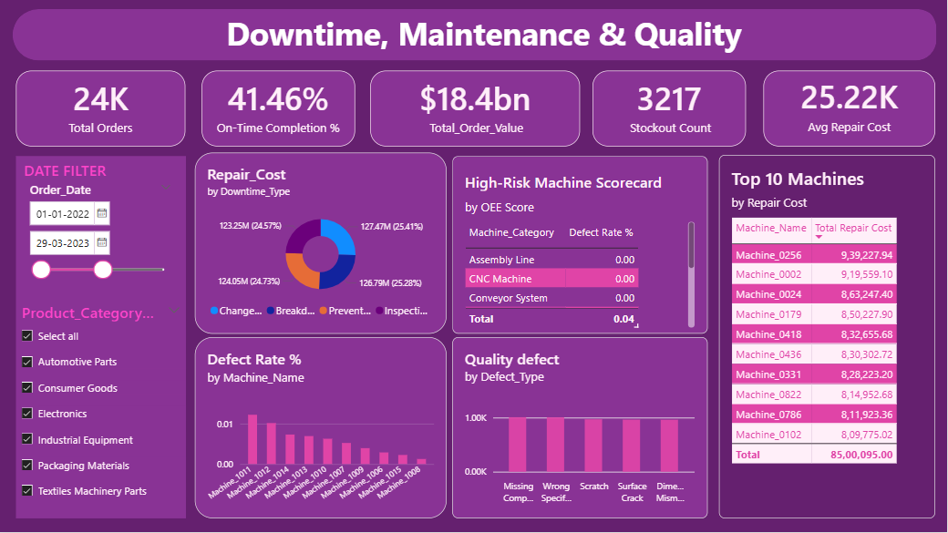
Dashboard 4: Downtime, Maintenance & Quality
The question it answers
Where does repair spend go, and what drives defects?
0.32%
overall defect rate (units per 100 planned)
≈25%
of repair cost for each downtime type
19.6–20.5%
share of each of the five defect types
Screenshot shows the date slicer set to Jan 2022 – Mar 2023. Figures quoted in this deck use the full dataset (Jan 2022 – Jun 2024).
Notes:
Maintenance and quality view: repair cost by downtime type, defect rate by machine and category, and the defect type mix.

Slide 19
Dashboard 4: what each visual tells us
Visual | What it shows | What we found
Repair Cost by Downtime Type | Where repair spend goes | Changeover ₹127.5M, Breakdown ₹126.8M, Preventive ₹124.1M, Inspection ₹123.3M: each about 25%.
Defect Rate by Machine | Machines with the highest defect rate | Machine_0958 (0.99%), Machine_0590 and Machine_0080 (0.93%) vs 0.32% overall.
Defect Type Distribution | Defect records by type | Almost even: Missing Component 1,007, Wrong Specification 1,005, then 969, 963, 961.
Defect Rate by Machine Category | Defective units per 100 planned | From 0.29% (Quality Scanner) to 0.34% (Packaging Unit); overall 0.32%.
So what: Spend and defect causes are evenly spread; the gains are in the few machines near a 1% defect rate.
Notes:
No single downtime type or defect type dominates. Missing Component and Wrong Specification are only slightly ahead of the rest.

Slide 20
Recommended next steps
1
Attack late deliveries first: review scheduling and capacity planning. The problem is plant-wide, not tied to machine tier.
2
Run a maintenance and quality review on the 45 high-risk machines, starting with Conveyor Systems and Injection Molding.
3
Rebalance inventory: replenish the biggest shortfalls (for example PN1805 in Kolkata) and review overstocked items.
4
Tackle the top two defect causes, missing components and wrong specification, with assembly and specification checks.
5
Fix data gaps: 52 machines with OEE above 100 and 48 orders with no order date.
Notes:
Actions follow directly from the dashboard findings, in order of expected impact on delivery, downtime, cost and quality.

